Slide 1



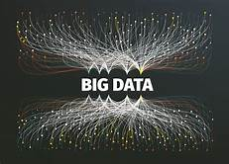

MODERN BIG DATA ANALYSIS WITH SQL
Foundation for Big Data Analysis with SQL
Analyzing Big Data with SQL
Managing Big Data in Clusters and Cloud Storage

Slide 2
DATA AND BIG DATA
Data - information efficient for movement/processing.
For recent, it is information converted into binary digital form.
Big data - large volume of data
Structured and unstructured
Helpful for business on a daily basis.
Big Data - helps companies generate valuable insights.
Refine their marketing campaigns, techniques, machine learning projects to train machines, predictive modeling, etc.

Slide 3


COURSE 1 : Foundation for Big Data Analysis with SQL
NEED FOR ORGANISING DATA
Logical and consistent way
Allows to easily locate and use information or data.
Saves time and frustration
Find what you need when you need it.
ANALOG DATA
Analog data - data represented in a physical way. Stored in physical media
Ex: surface grooves on a vinyl record, the magnetic tape of a VCR cassette etc.

Slide 4
DIGITAL DATA AND DBMS
DIGITAL DATA
Digital data - information represented - string of discrete symbols each of which can take on one of only a finite number of values. As letters or digits.
Information theory and information systems
DBMS
Database Management Systems (DBMS) - software systems
Store, retrieve, and run queries on data
Interface between an end-user and a database
Create, read, update, and delete data in the database.

Slide 5
OPERATIONAL AND ANALYTIC DATABASES
An operational database - stores data inside of an enterprise
Easy and quick updates
Most up-to-date information
Like payroll records, customer information and employee data.
An analytic database - for business analytics applications
Specifically designed to support business intelligence (BI) and analytic applications, different for different organization
More efficient analysis

Slide 6
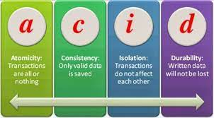
RDBMS, SQL AND ACID
RDBMS AND SQL
RDBMS - Relational Database Management System. Basis for SQL and for all modern database systems like MS SQL Server, IBM DB2, Oracle, MySQL, and Microsoft Access.
ACID
ACID - atomicity, consistency, isolation, durability
Database transactions
Guarantee data validity despite errors, power failures, and other mishaps.

Slide 7
NORMALIZATION AND DENORMALIZATION OF DATA
Normalization is the process of organizing the data in the database. It is basically used to minimize the redundancy from a relation or set of relations.
Denormalization is a database optimization technique in which we add redundant data to one or more tables. This can help us avoid costly joins in a relational database.

Slide 8


IMPALA AND HIVE
APACHE IMPALA
Impala lets more users, whether using SQL queries or BI applications, interact with more data through a single repository and metadata store from source through analysis. It is faster than hive.
APACHE HIVE
The Apache Hive data warehouse software facilitates reading, writing, and managing large datasets residing in distributed storage using SQL.

Slide 9
COURSE 2 : Analyzing Big Data with SQL
VIRTUAL MACHINE
A Virtual Machine is a compute resource that uses software instead of a physical computer to run programs and deploy apps.
HUE QUERY EDITOR
Data architects, SQL developers, and data engineers use Hue to create data models, clean data to prepare it for analysis, and to build and test SQL scripts for applications. Hue is a web-based interactive query editor that enables you to interact with databases and data warehouses.

Slide 10
DATA TYPES AND OPERATORS
DATA TYPES
Data type is an attribute associated with a piece of data that tells a computer system how to interpret its value. Understanding data types ensures that data is collected in the preferred format and the value of each property is as expected.
OPERATORS
An operator is a symbol that tells the compiler to perform specific mathematical or logical functions like Arithmetic, relational, etc.

Slide 11
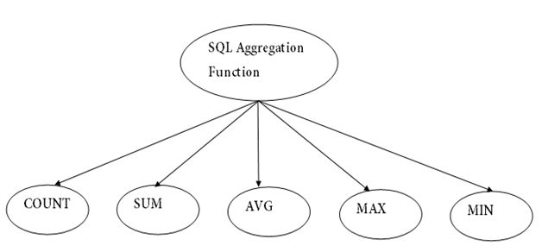
AGGREGATE
SQL aggregation function is used to perform the calculations on multiple rows of a single column of a table. It returns a single value. It is also used to summarize the data.

Slide 12
ORDER BY AND JOINS
ORDER BY CLAUSE
The SQL ORDER BY clause is used to sort the data in ascending or descending order, based on one or more columns. Some databases sort the query results in an ascending order by default.
JOINS
In case of SQL, JOIN means to combine two or more tables. JOINS are INNER JOIN, LEFT JOIN, RIGHT JOIN and FULL JOIN.

Slide 13
COURSE 3 : Managing Big Data in Clusters and Cloud Storage
CLOUD STORAGE
Cloud storage is a cloud computing model that stores data on the Internet through a cloud computing provider who manages and operates data storage as a service. It’s delivered on demand with just-in-time capacity and costs, and eliminates buying and managing your own data storage infrastructure. This gives you agility, global scale and durability, with anytime, anywhere data access.
STATEMENTS
A statement is any text that the database engine recognizes as a valid command. An SQL-statement is a string of characters that conforms to the format and syntax rules specified in this international standard.

Slide 14
CREATING TABLES AND TBLPROPERTIES
CREATING TABLES
Creating a basic table involves naming the table and defining its columns and each column's data type. The SQL CREATE TABLE statement is used to create a new table.
TBLPROPERTIES
The TBLPROPERTIES clause allows you to tag the table definition with your own metadata key/value pairs.

Slide 15
MODIFYING AND REMOVING TABLES
Hive provides us the functionality to perform Alteration on the Tables and Databases. ALTER TABLE command can be used to perform alterations on the tables.
When you drop a table from Hive Metastore, it removes the table/column data and their metadata. It can be a normal table (stored in Metastore) or an external table (stored in local file system), Hive treats both in the same manner, irrespective of their types.

Slide 16
FILE FORMAT AND DATA MANAGEMENT
FILE FORMAT
A file format is the way in which information is stored or encoded in a computer file. In Hive it refers to how records are stored inside the file. As we are dealing with structured data, each record has to be its own structure. How records are encoded in a file defines a file format.
DATA MANAGEMENT
Data management is the process of ingesting, storing, organizing and maintaining the data created and collected by an organization.

Slide 17
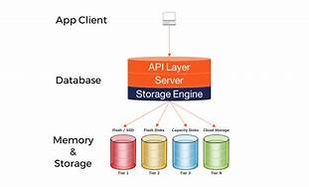
STORAGE ENGINES
A database engine (or storage engine) is the underlying software component that a database management system (DBMS) uses to create, read, update and delete (CRUD) data from a database.

Slide 18


HANDS ON PROJECT

Slide 19
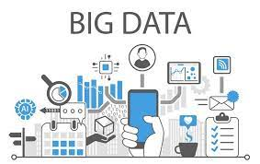

THANKS!

